Slide 1
Lecture 32
Dec. 1st , 2019
Happy Thanksgiving! Thank goodness for safe returns.
Return lab 6-7
  Discuss
Discuss Drosophila analysis
Exam 3 returned Friday if possible
GFP paper returned Monday
Last labs this week and next—molecular genotyping

Slide 2
Where were we?
DNA as a chemical---

Slide 3
Be sure you can….
Sketch nucleoptides
Recognize small differences in structure/chemical make up!
Be sure to be able to distinguish between:
dNTPs and NTPs
dNMPs, dNDPs, dNTPs
Be able to recognize a stretch of RNA from a single strand of DNA….

Slide 4
DNA/RNA made of chemically linked nucleotides
Specific type of linkage joins adjacent nucleotides
  5’ carbon of one nucleotide forms a linkage to the 3’ carbon of the adjacent nucleotide
    Phosphate links 2 nucleotides in a phophodiester bond

Slide 5
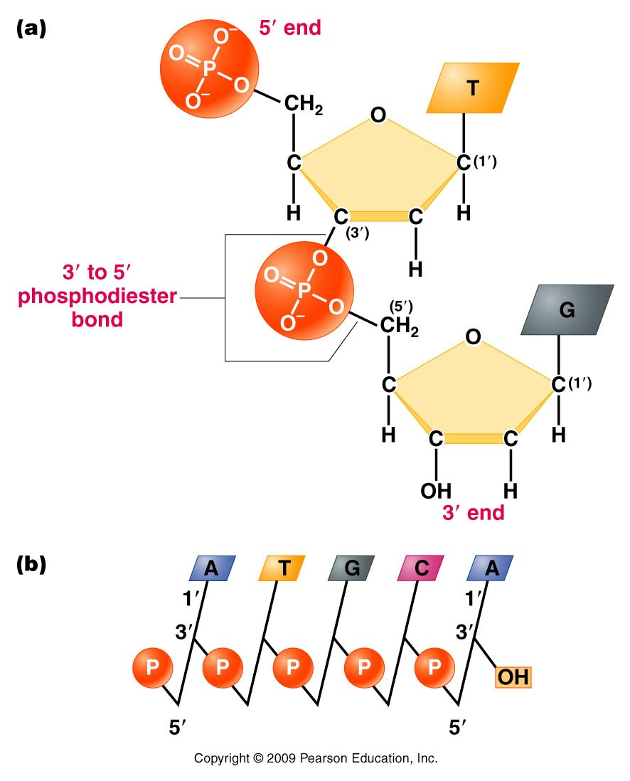
Result is a 5’-3’ linkage and a molecule with 5’ and 3’ ends.
A strand of DNA/RNA
Figure 10.12
Notes:
Figure 10-12 (a) Linkage of two nucleotides by the formation of a C-3’ –C-5’ (3’ –5’) phosphodiester bond, producing a dinucleotide. (b) Shorthand notation for a polynucleotide chain.

Slide 6
RNA exists as a single strand* of nucleotides
DNA is a double strand of nucleotides
  Strands are connected via non-covalent bonds between specific bases.
    Adenine bonds to Thymine
    Cytosine bonds to Guanine
    * adenine and uracil (and cytosine and guanine) can form bonds in regions of an RNA single strand or in DNA-RNA hybrids.
Complementary base pairing

Slide 7
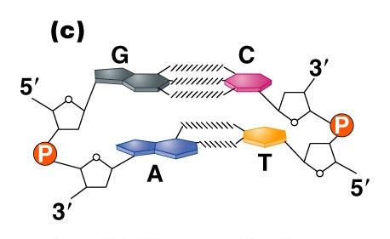
Figure 10.14c
Notes:
Figure 10_14c (a) The DNA double helix as proposed by Watson and Crick. The ribbonlike strands constitute the sugar-phosphate backbones, and the horizontal rungs constitute the nitrogenous base pairs, of which there are 10 per complete turn. The major and minor grooves are apparent. The solid vertical bar represents the central axis. (b) A detailed view depicting the bases, sugars, phosphates, and hydrogen bonds of the helix. (c) A demonstration of the antiparallel nature of the helix and the horizontal stacking of the bases.

Slide 8
Complementary base pairing requires the DNA strands run in opposite directions with respect to 5’ and 3’ ends. (Antiparallel strands)
Complementary base pairing is only possible with a slight twist to each successive base pair. The twisting to accommodate pairing, creates the helical molecule.

Slide 9
(How do we know)? Determining DNA structure…
Double helix is 63 years old!! (knowledge of DNA structure) Published April 25th, 1953.
Watson JD. Crick FHC. A structure for deoxyribose nucleic acid. 1953; Nature 171:737-8.
  Watson and Crick got most of the glory…but the discovery of the structure was a very much a group effort.

Slide 10
It began with biochemical studies…
Erwin Chargaff—studied DNA by base composition.
  Noted roughly equal concentrations of:
    Purines and Pyrimidines
    Specifically: [A] = [T] and [C] =[G]

Slide 11
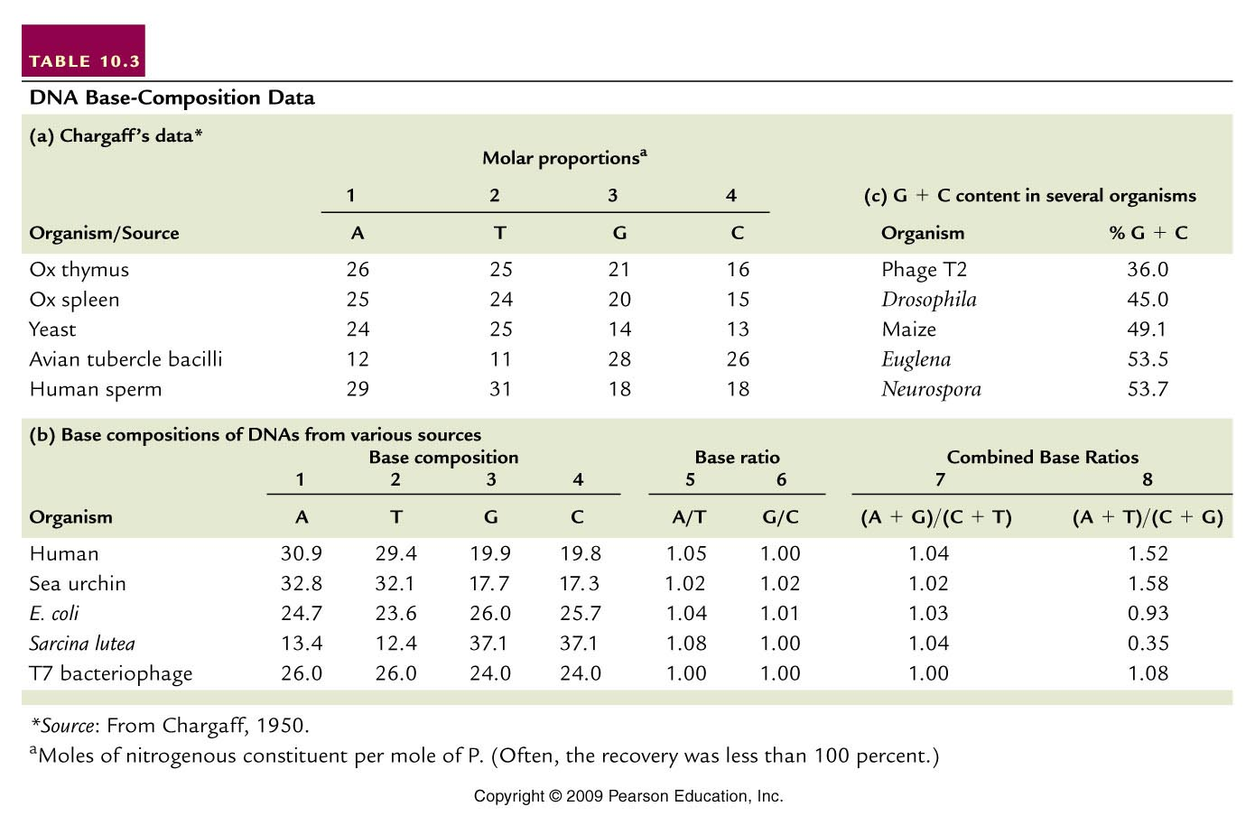
(purines=pyrimidines)
(A+T not = G +C)
Table 10.3
Notes:
Table 10.3 DNA Base Composition Data

Slide 12
  Suggested 1:1 interactions of specific bases.
  A-T and G-C
  Eventually this biochemical ratio supported the specific A-T and G-C base-pairing scheme which facilitates the interaction of 2 DNA strands.

Slide 13
  Interestingly---different species have different base compositions---Some are more A/T rich some are more G/C rich.
  Humans have more A-T base-pairs than G-C base pairs.
  A bacterial species—Sarcinia lutea has more G-C than A-T base pairs.

Slide 14
(purines=pyrimidines)
(A+T not = G +C)
Table 10.3
Notes:
Table 10.3 DNA Base Composition Data

Slide 15
Details of 3-D DNA structure came from X-ray diffraction experiments/pictures
  X-ray diffraction gives a pattern of dots which result from X-rays bouncing off of electrons of the substance being analyzed
    The more regular the pattern the more likely the structure is a symmetrical/repeated shape (the pattern for DNA resembled a helix)

Slide 16
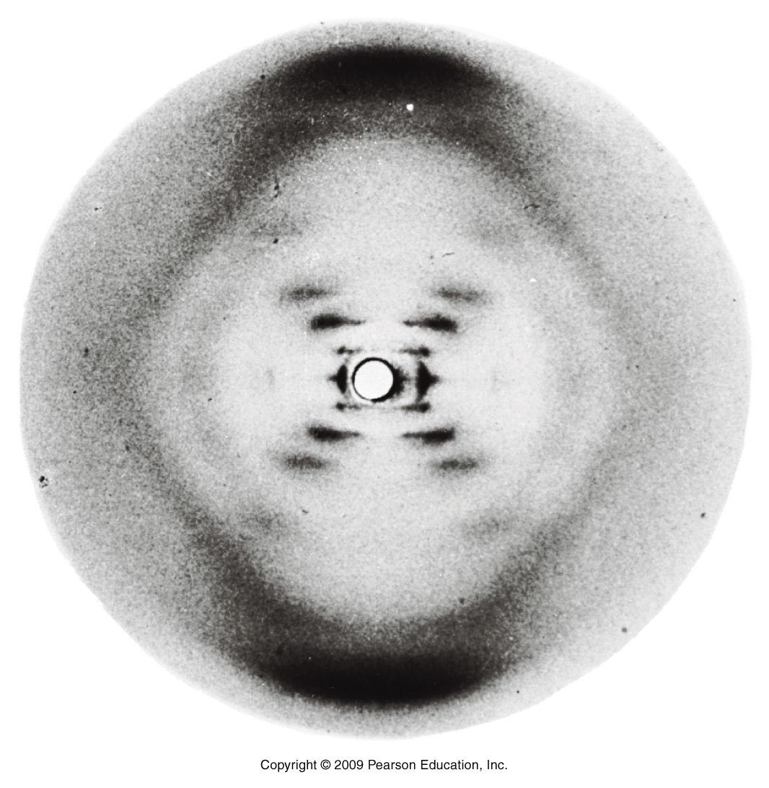
Figure 10.13
Notes:
Figure 10-13 X-ray diffraction photograph of the B form of purified DNA fibers. The strong arcs on the periphery show closely spaced aspects of the molecule, providing an estimate of the periodicity of nitrogenous bases, which are 3.4 Å apart. The inner cross pattern of spots shows the grosser aspect of the molecule, indicating its helical nature.

Slide 17
Many scientists used X-ray diffraction to try to solve DNA structure
Linus Pauling
William Astbury
Raymond Gosling (little known) http://en.wikipedia.org/wiki/Raymond_Gosling
Maurice Wilkins*
Rosalind Franklin
James Watson*
Francis Crick*
*Awarded the Nobel prize in 1962

Slide 18
Rosalind Franklin provided the most definitive X-ray picture
“ Photo 51”
Was not recognized as a major contributor until after her death.

Slide 19
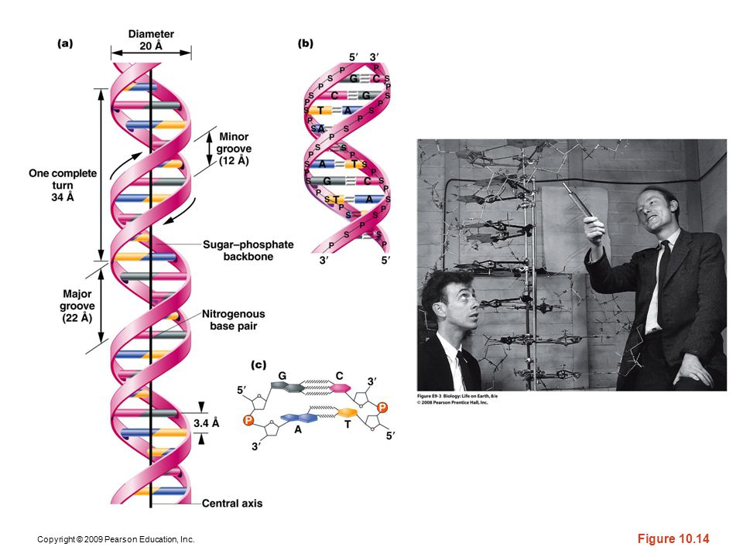
The Watson-Crick Model---Also known as B-DNA
Figure 10.14
Notes:
Figure 10-14 (a) The DNA double helix as proposed by Watson and Crick. The ribbonlike strands constitute the sugar-phosphate backbones, and the horizontal rungs constitute the nitrogenous base pairs, of which there are 10 per complete turn. The major and minor grooves are apparent. The solid vertical bar represents the central axis. (b) A detailed view depicting the bases, sugars, phosphates, and hydrogen bonds of the helix. (c) A demonstration of the antiparallel nature of the helix and the horizontal stacking of the bases.

Slide 20
Read Watson and Crick’s complete paper published in 1953 in Nature journal.
P.248 of your text.
Read it!

Slide 21
Definitive X-ray diffraction on a complete DNA double helix was not possible until 1982!
As mentioned---this W-C model is known as B-DNA. In cells, and in experiments outside of cells (in vitro), DNA can assume variations on the B-DNA form. (Read about variations, C, D, E, Z, P DNA---p 249)

Slide 22
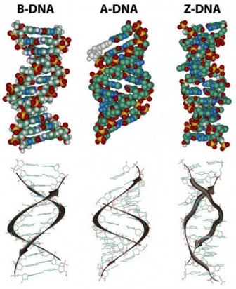
Figure 10-15

Slide 23
After the double helix…
…”It has not escaped our notice that the specific pairing we have postulated immediately suggests a possible copying mechanism for the genetic material”…
    Watson and Crick
    What did they mean? How did they see a mechanism for replication?

Slide 24
11.1 DNA Is Reproduced by Semiconservative Replication
Moving to chapter 11.

Slide 25
Semiconservative replication
  Replication of DNA occurs such that each new molecule is made of one “old” strand from the original parent molecule, and one newly synthesized strand.
    Each new molecule is partly concerved.

Slide 26
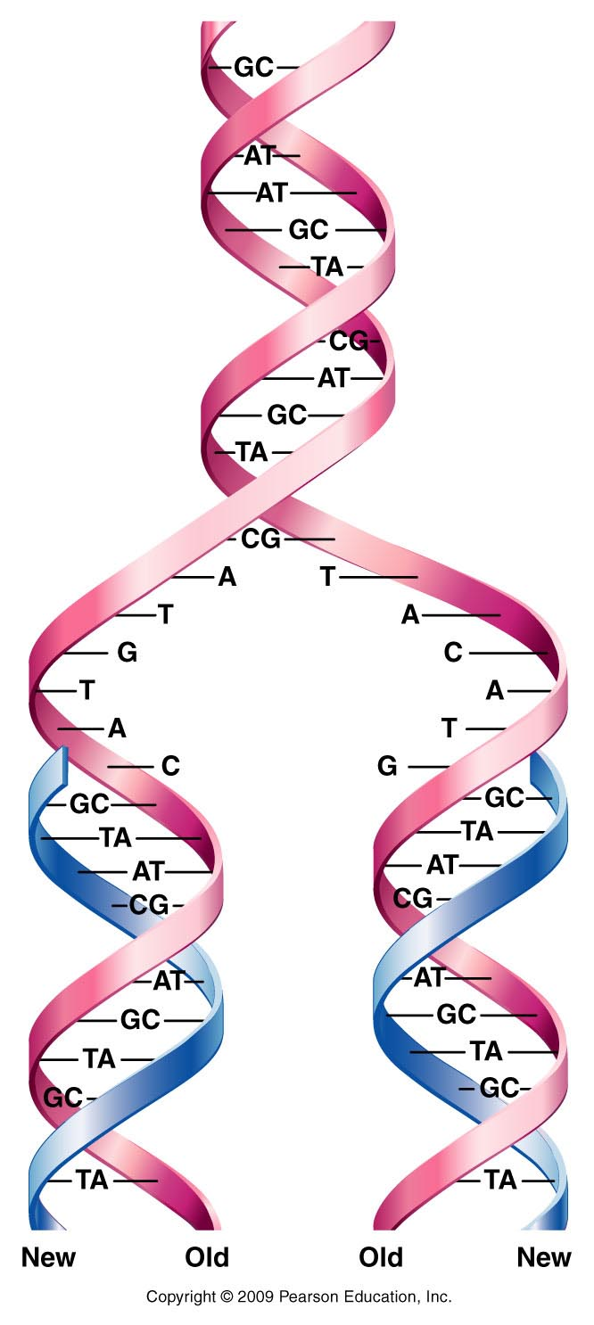
Figure 11.1
Notes:
Figure 11-1 Generalized model of semiconservative replication of DNA. New synthesis is shown in blue.

Slide 27
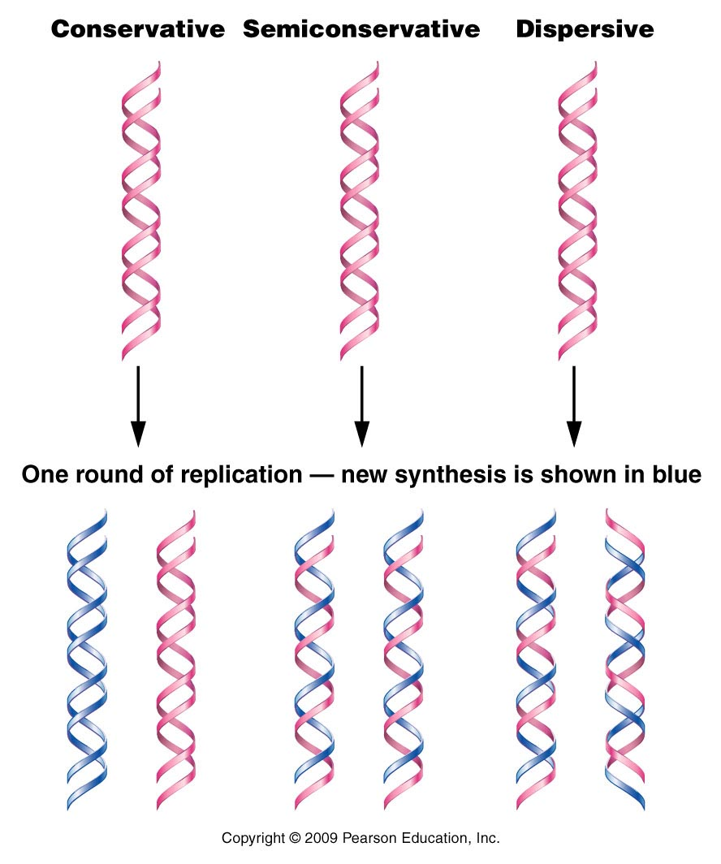
Other alternatives?
Figure 11.2
Notes:
Figure 11-2 Results of one round of replication of DNA for each of the three possible modes by which replication could be accomplished.

Slide 28
Experimental evidence—
Messelson and Stahl’s experiment
Like Hershey and Chase, used radiolabeling to distinguish how DNA was synthesized/copied.
What organism was used? E. coli
Hooray for E. coli!!!

Slide 29
The experiment
E.coli were grown in 2 types of LB broth.
  One had Nitrogen-14
  One had Nitrogen-15
  Nitrogen will be incorporated into nucleotide bases. DNA with N-15 is heavier, than DNA with N-14 and will sink faster in a centrifuging experiment.

Slide 30
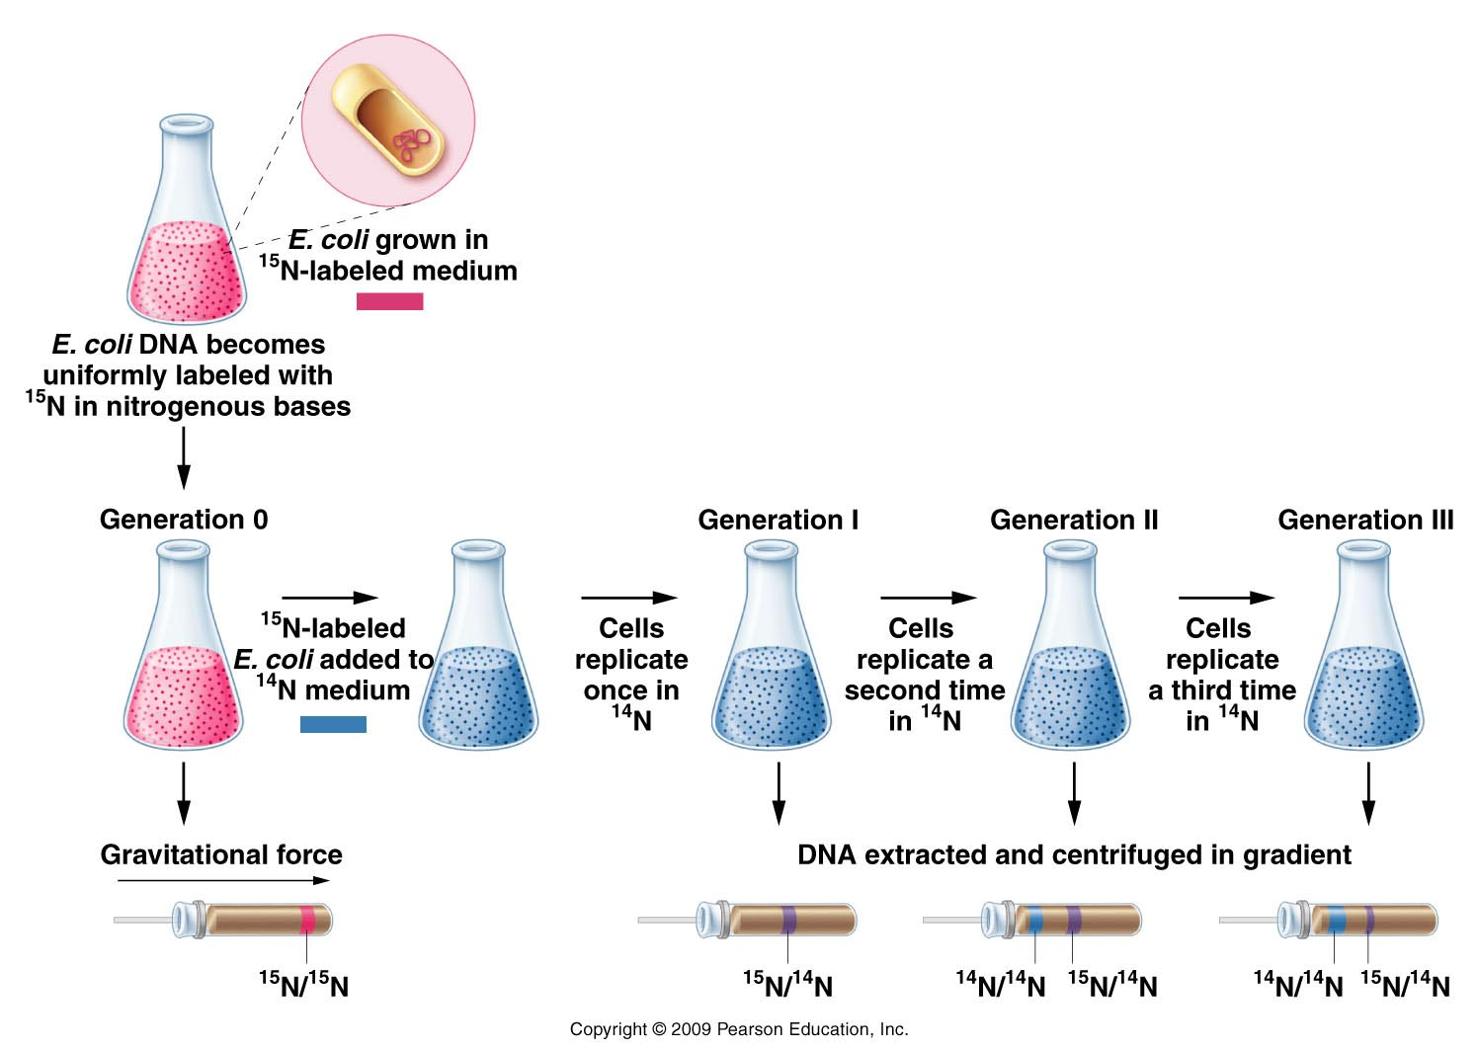
Figure 11.3
Notes:
Figure 11-3 The Meselson–Stahl experiment.

Slide 31
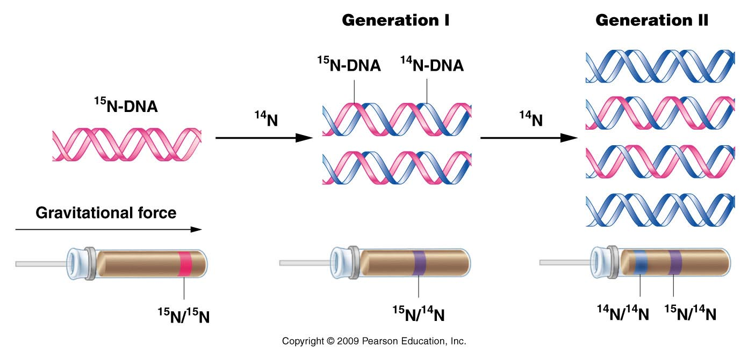
Figure 11.4
Notes:
Figure 11-4 The expected results of two generations of semiconservative replication in the Meselson–Stahl experiment.

Slide 32
The fact that the DNA was of intermediate weight after 1 round of replication supported the semi-conservative mechanism.
Why did the original DNA band disappear? Why did a lighter band begin to accumulate?
What might you expect after 2 rounds? 3 rounds? 100 rounds? Sketch the outcome using the same type of figure.
What would the result have looked like if DNA was replicated in a completely conservative manner?

Slide 33
Others added support for M-S experiment.
  Taylor, Woods, Hughes
    Also used radiolabeling of DNA, but looked at chromosomes microscopically. After radioisotope is removed and several rounds of replication, can observe that one chromatid of some of the chromosomes remains labeled, while other chromatid is not.

Slide 34
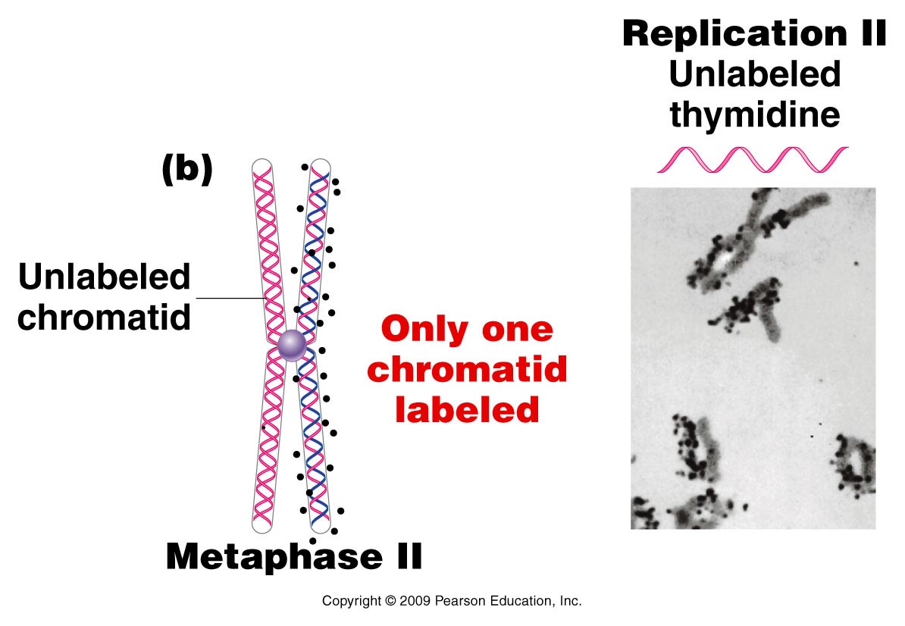
Figure 11.5b
Notes:
Figure 11-5b The Taylor–Woods–Hughes experiment, demonstrating the semiconservative mode of replication of DNA in root tips of Vicia faba. A portion of the plant is shown in the top photograph. (a) An unlabeled chromosome proceeds through the cell cycle in the presence of 3H-thymidine. As it enters mitosis, both sister chromatids of the chromosome are labeled, as shown, by autoradiography. After a second round of replication (b), this time in the absence of 3H-thymidine, only one chromatid of each chromosome is expected to be surrounded by grains. Except where a reciprocal exchange has occurred between sister chromatids (c), the expectation was upheld. The micrographs are of the actual autoradiograms obtained in the experiment.

Slide 35
A closer look at DNA replication…
What occurs at the molecular level?
In 1957 Arthur Kornberg provided first evidence of a DNA replicating enzyme. Isolated it from E. coli
  Called it DNA polymerase because it seemed to be able to link nucleotides to create a nucleotide polymer.

Slide 36
Kornberg needed to add provide this enzyme with:
Existing DNA molecule to copy (now called the template)
DNA building blocks---nucleotides
-tri-phosphate forms (dTTP, dATP, dCTP, dGTP) together, referred to as dNTPs.
N=any of the 4 deoxyribonucleotides.

Slide 37
Enzyme called DNA polymerase I---first one to be isolated. Now know that E. coli makes
I
II
III
IV
V

Slide 38
Kornberg’s discovery…
Enzyme called DNA polymerase I---first one to be isolated. Now know that E. coli makes
I
II
III---actually the enzyme that does most of the DNA synthesis in E. coli
IV
V

Slide 39
DNA replication…
Kornberg’s DNA polymerase I (and all DNA polymerases) link nucleotides in a 5’ 3’ direction.
Nucleoside triphosphates (dNTPs) are hydrolzyed to nucleoside monophosphates (dMTPs) with the release of inorganic phosphate.

Slide 40
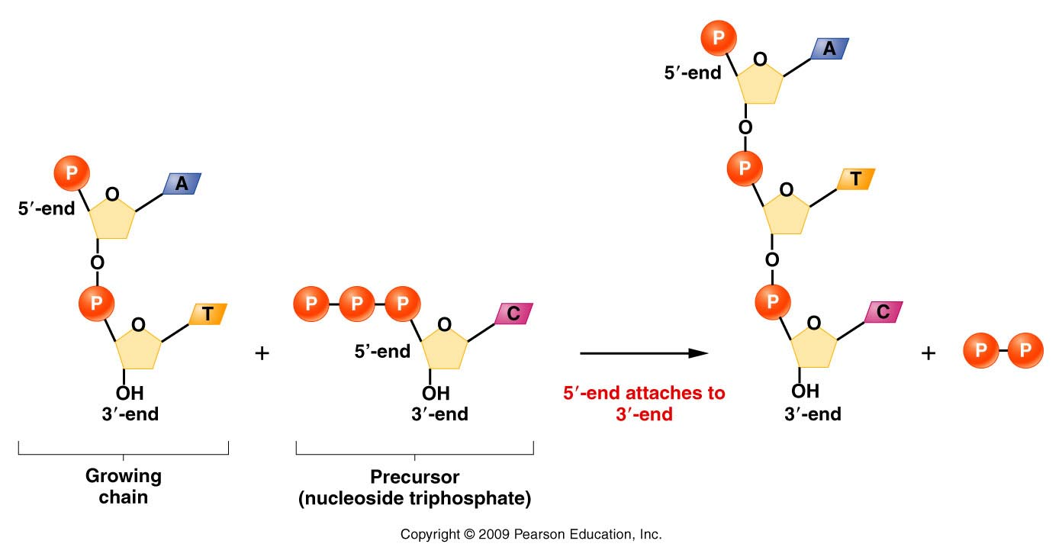
Figure 11.8
Notes:
Figure 11-8 Demonstration of 5’ to 3’ synthesis of DNA.

Slide 41
Now realize that DNA polymerases can only extend existing stretch of DNA. Cannot start a new strand from scratch.
  DNA polymerases require a nucleic acid “primer”.
    In cells this primer is a short stretch of RNA (made by an RNA polymerase). In in vitro replication the primer can be RNA or DNA.

Slide 42
DNA polymerases require a free 3’0H group.
Figure 11.8
Notes:
42
Figure 11-8 Demonstration of 5’ to 3’ synthesis of DNA.

Slide 43
Where does a DNA molecule begin its replication?...
Specific regions of chromosome are recognized by proteins that help open the helix and expose each strand.
  Region of the DNA is called:
    Origin of replication [Ori] (in prokaryotes)
    Autonomously replicating sequences (ARS) [in eukaryotes]

Slide 44
The Ori/ARS region is typically rich in A-T base pairs.
Why more A-T base pairs than G-C base pairs in these regions?

Slide 45
Recall the question regarding pGLO plasmid in lab? Does the plasmid replicate in the transformed bacteria? Yes!
And the only way any DNA molecule can be replicated is if it has within its sequence a signal for replication. (part of an E.coli origin of replication is shown here.)
GAT CTATTTATTT AGAGATCTGT TCTATTGTGA TCTCTTATTA

Slide 46
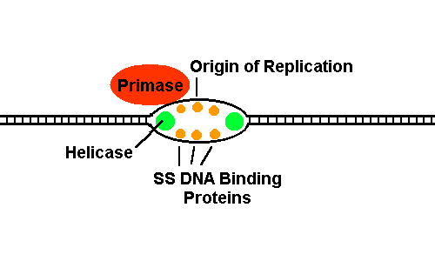
Note that this sequence is A-T rich!
A-T base pairs have 2 hydrogen bonds whereas G-C base pairs have 3 hydrogen bonds.
  Less energy required to break A-T bp.
Once open, the origin resembles a small bubble in the DNA

Slide 47
DNA polymerase must have many helper proteins…

Slide 48
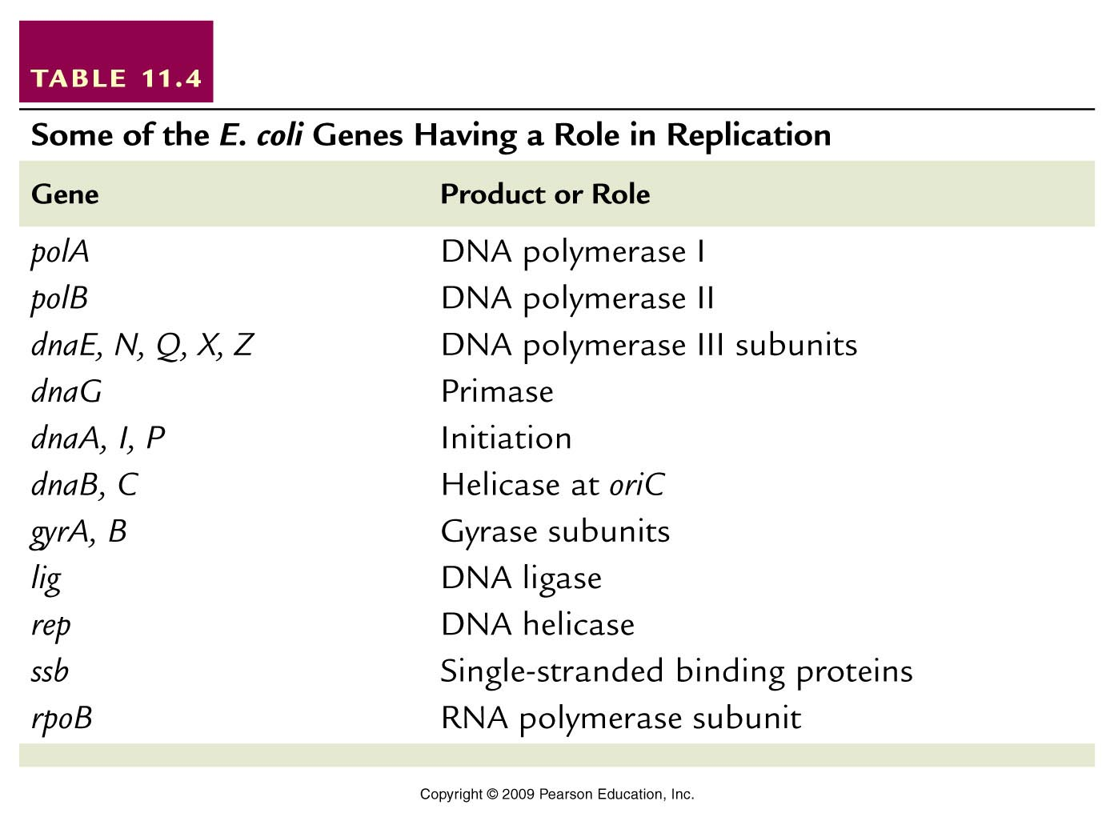
Helper proteins
Table 11.4
Notes:
Table 11-4 Some of the E. coli Genes Having a Role in Replication

